Slide 1
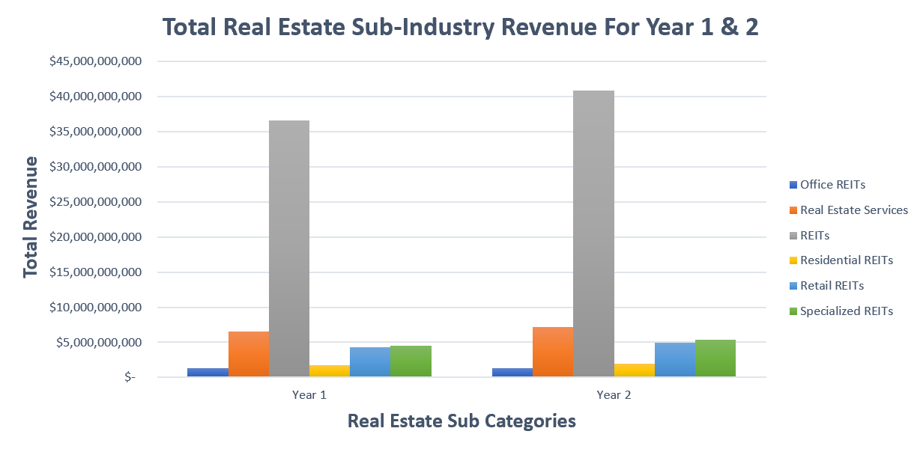
Comparing the total Revenue of Real Estate for year one and year two
The bar graph shows the total revenue of all the real estate sub-industries for years one and two
The mean for Year one is around $1.2 billion, and the median was $1.8 billion, while the mean for Year two is around $2.4 billion, and the median is around $2.1 billion. This shows a slightly right-skewed distribution in both years, with an average growth of about $1.2 billion for year two.
The REITs sub-industry contributes to over 70% of real estate's total revenue, indicating an outlier in the distribution. The standard deviation is also slightly higher in Year two with $1.9 billion vs. Year one with $1.7 billion, which means the variability and growth in Year two than in Year one.

